Slide 1
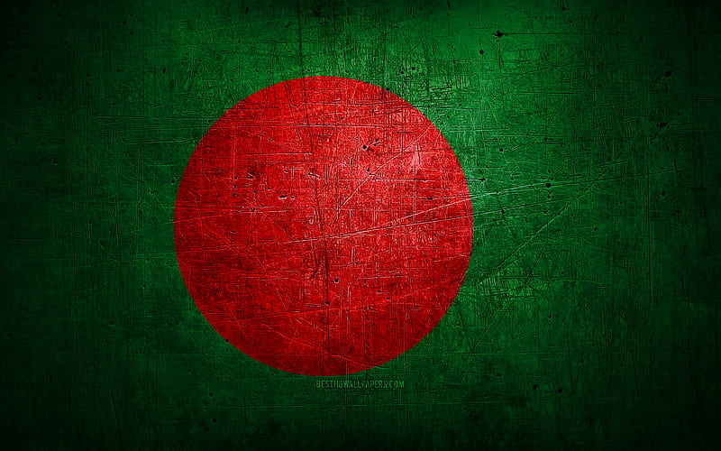
Introduction To Bangladesh
Bangladesh is a vibrant South Asian country known for its rich history, diverse culture, and picturesque landscapes. Located on the Bay of Bengal, it boasts a growing economy and dynamic population.

Slide 2
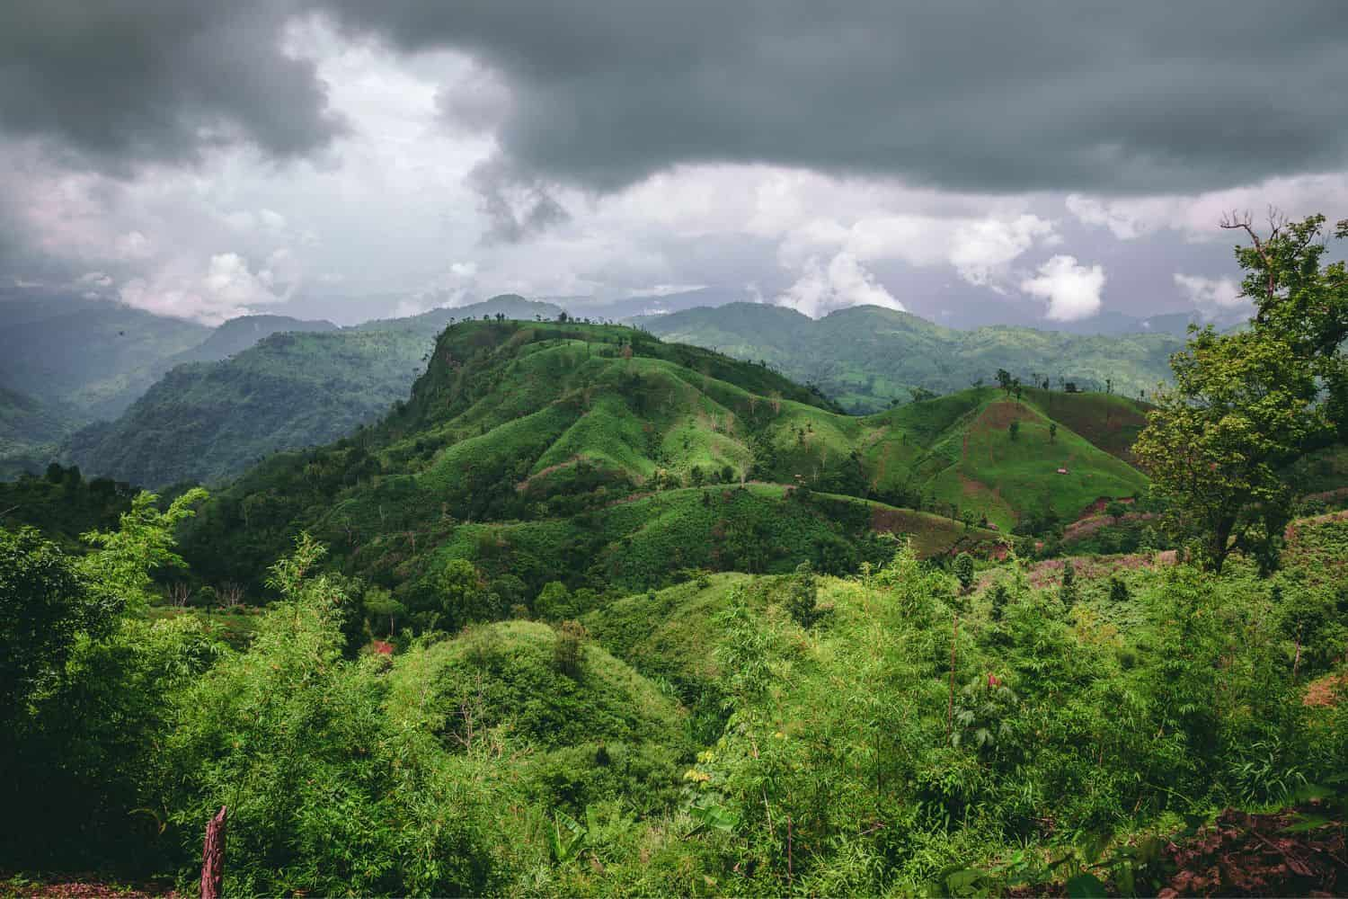
Geography and Climate
Bangladesh is a low-lying country with a vast river system, including the Ganges and Brahmaputra. It has a tropical climate, characterized by hot summers, heavy monsoons, and mild winters.

Slide 3
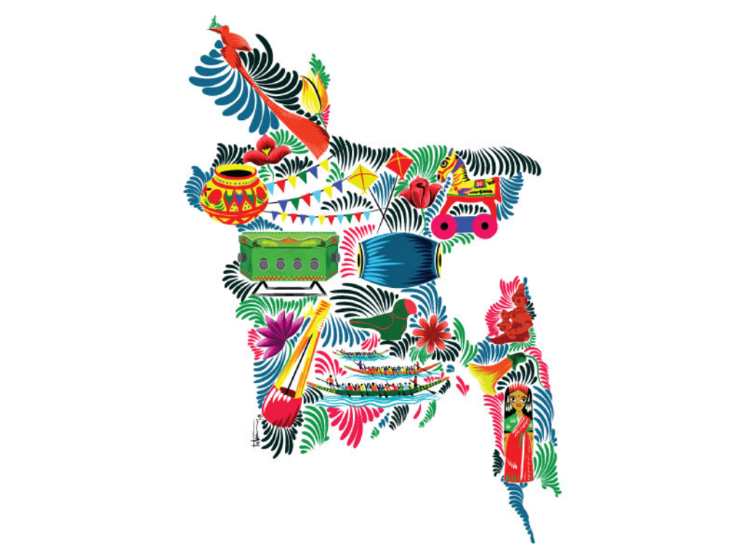
Cultural Heritage
Bangladesh’s cultural heritage blends Bengali traditions with Islamic influences. It celebrates vibrant festivals like Pohela Boishakh, features traditional music and dance, and is known for its distinctive cuisine, textiles, and arts.

Slide 4

Economy of Bangladesh
Bangladesh’s economy is driven by textiles, agriculture, and remittances. The country has experienced rapid growth, with major exports including garments, jute, and seafood, though challenges like poverty and infrastructure remain.

Slide 5
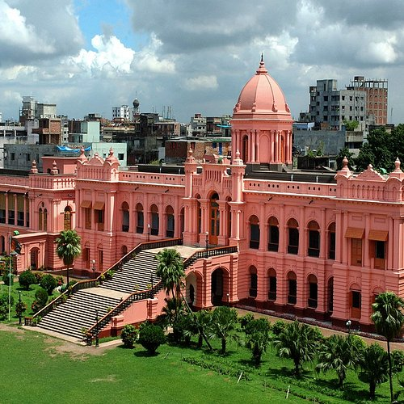
Landmarks in Bangladesh
Bangladesh offers diverse tourism, from the world’s longest beach at Cox's Bazar to the UNESCO-listed Sundarbans. Historical sites like Lalbagh Fort, Srimangal’s tea gardens, and vibrant cultural landmarks attract visitors globally.

Slide 6

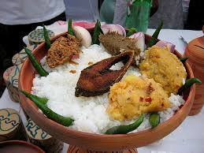
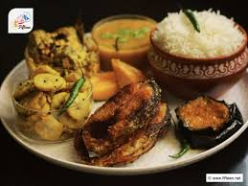

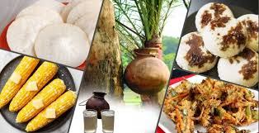
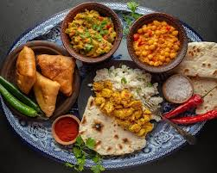
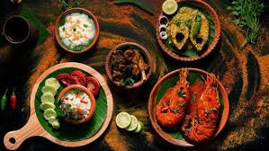
Culinary
Delights
of
Bangladesh

Slide 7
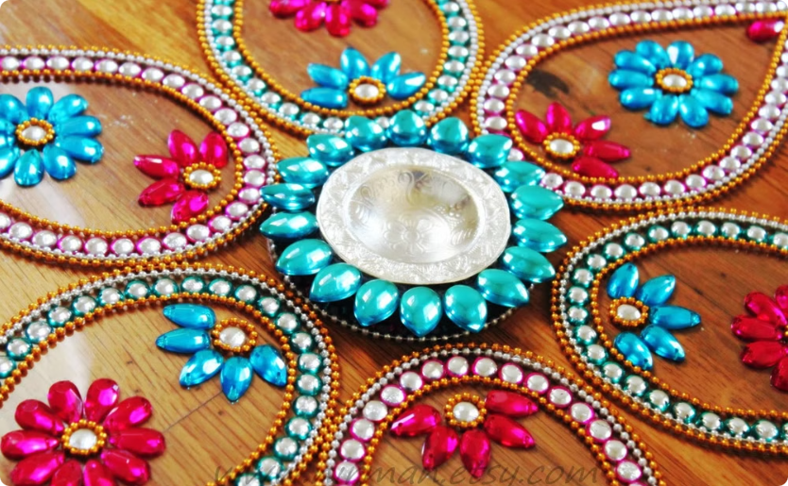

The Vibrant Alpana: Artistic Heritage of Bangladesh
Traditional Art Form
Symbolic Designs
Alpana, a form of folk art, involves creating intricate designs using rice paste and other natural materials.
The designs often symbolize auspicious themes, religious beliefs, and cultural traditions.

Slide 8


National Animals of Bangladesh
Royal Bengal Tiger
The national animal of Bangladesh, the Bengal tiger is a majestic creature known for its strength and beauty. The Bengal tiger is an iconic symbol of Bangladesh's wildlife and cultural heritage.

Slide 9
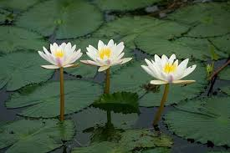
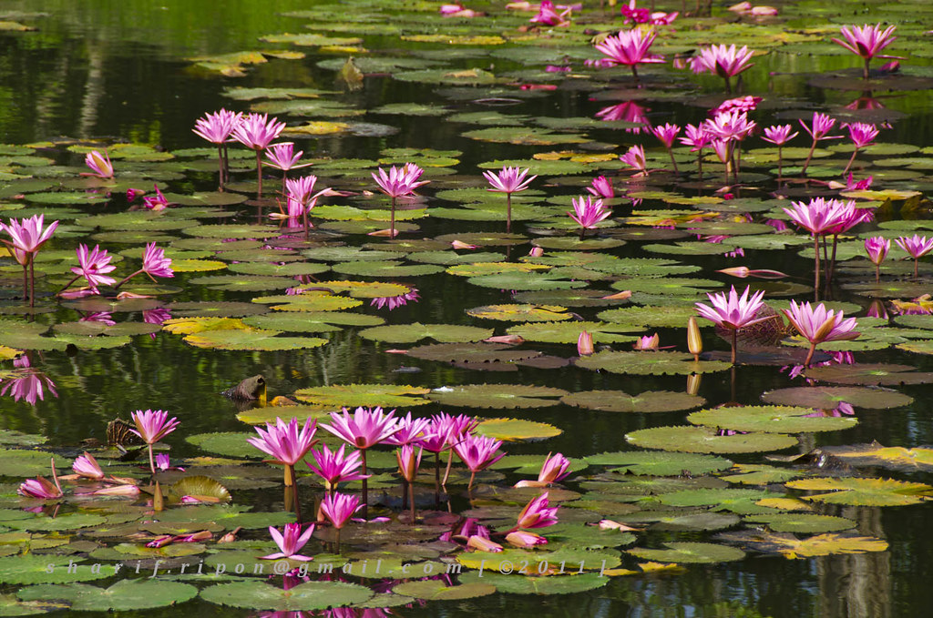
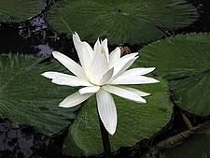
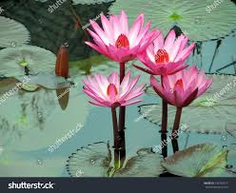
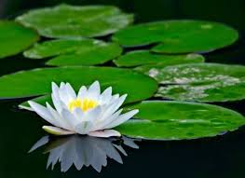
The National Flower of Bangladesh
Water Lily
The national flower of Bangladesh, the water lily is known for its beauty and its association with purity and peace. The water lily is a symbol of the country's lush and vibrant natural landscapes.

Slide 10
Thank You

